Slide 1



A CENTER FOR INTER-DISCIPLINARY RESEARCH
2021-22
TITLE
“LIBRARY MANAGEMENT SYSTEM”
SUPERVISED BY
HARIKA GUMMADI
GOKARAJU RANGARAJU
INSTITUTE OF ENGINEERING AND TECHNOLOGY
AUTONOMOUS

Slide 2
Advanced Academic Center
( A Center For Inter-Disciplinary Research )
This is to certify that the project titled
“FLIGHT FAIR PREDICTION USING RANDOM FOREST”
is a bonafide work carried out by the following students in partial fulfilment of the requirements for Advanced Academic Center intern, submitted to the chair, AAC during the academic year 2021-22.
NAME | ROLL NO. | BRANCH
MALLELA MOUNIKA REDDY | 20241A12E7 | IT
MEDISHETTY SUMANA | 20241A12F1 | IT
NIKHIL NYALAKANTI | 20241A12G0 | IT

Slide 3
NAME | ROLL N0 | BRANCH
SWALENKA SAI SHRADDHA | 20241A12H1 | IT
UPPU AKSHAY | 20241A12H5 | IT
YAMADRI AMBIKA | 20241A12H9 | IT
This work was not submitted or published earlier for any study
Dr/Ms./Mr.
Dr.B.R.K.Reddy
Program Coordinator
Dr. G. Ramesh
Dean, AAC
Project Supervisor

Slide 4
ACKNOWLEDGEMENTS
We express our deep sense of gratitude to our respected Director, Gokaraju Rangaraju Institute of Engineering and Technology, for the valuable guidance and for permitting us to carry out this project.
With immense pleasure, we extend our appreciation to our respected Principal, for permitting us to carry out this project.
We are thankful to the Associate Dean, Advanced Academic Centre, for providing us an appropriate environment required for the project completion.
We are grateful to our project supervisor who spared valuable time to influence us with their novel insights.
We are indebted to all the above mentioned people without whom we would not have concluded the project.

Slide 5
ABSTRACT
To develop a website which keeps track of all the library books, to check the availability of a required book.
The Library Management System is an application for assisting a librarian in managing a book library in university. The system would provide a basic set of features to add/update members, add/update books, and manage check-in specifications for the systems based on the client’s statement of need.
The Library Management system (LMS) acts as a tool to transform traditional libraries into digital libraries. In traditional libraries, the students/user has to search for books which are a hassle process and there is no proper maintenance of databases about issues/fines.
Website consists of:
Home: It reverts us back to the home page
Books: It gives us info about the books and their availability
Student-login: *Login page for the students
Admin-login: *Login page for the admin
Feedback
The website’s logo and title

Slide 6

INTRODUCTION
A library is a place where a huge collection of books and resources are available which can be accessible by the users. It acts as a brain for the institutions. It enhances the dissemination of knowledge and spiritual civilization among the students. The tons of books and research works are captivating the students to improvise their knowledge in all perspectives. It guides the students to promote their views differently. This knowledge optimizes the student to achieve a better result in academic as well as personal skill development. Improvisation in technology causes the demand for developing a way to enhance the traditional library set up to digital one.
Numerous tedious processes reduce the efficiency of the library. For example, it always needs manual support to do any activities in the traditional library. The count and details of books are scribbled in the paper for reference. Each data is fetched in the notebook for future citations. To examine any data then they have to refer the notebooks. At the same time while distributing the books to the students they have to enter into the notebook where they need to represent the book id, distribution and renewal date, and student id. The librarians/staff have to assign a tag for each book and provide an id for it. They have to align and arrange the books on the shelves and marked it. Missing or theft of the book builds a serious issue and confusion to the librarians. While collecting the book from the students they have to verify the penalties of the books. Therefore it causes a monotonous among the staff.
Consequently, it builds an uninteresting among the student due to the slow progress of the staff. To evoke the library into the technological era, we presented a system called the Library Management system (LMS). It is an automatic system that reduces the work burden of the staff/librarians through a single click. It will manage, organize and oriented the library task. The LMS supports the librarian to add/view/delete/update details from the library stock. Here we integrate all the library data into the SQL server. Preliminarily the librarian has to add student and book details into the database. After that he/she can view/delete/update those details through the Library Management system. On account of this, the user can access the library at any time.
The librarians can assist the data without any confusion. Each data are retrieved from the database. if he/she access any user details then it shows username, id, book details, and penalty details. They no need to write it on paper for any references. By editing the data they can change the parameter in it.

Slide 7
In spite of working on the manual, the librarian can feel easy to handle the automatic system. It has more additional features such as librarian can maintain library records, student’s history of penalties and issues. It always tracks the count of the book in the library and issued book details. This causes a flexible service for librarians and students. It is a user-friendly interface, so basic computer knowledge is enough to access the LMS. The system is a customizable and user-configurable one which causes it to use in different organizations. We represent the LMS with Admin module. We built the LMS in .Net Technology which is considered as the one of the upcoming technology in IT industries. By the integration of all the modules, it will be presented on the desktop of your computer.
The project scope:
To have a user-friendly and easy-to-use database application for library management.
To have an application that secures data records.
To have an application that generates reports on books, due reports, fine reports, etc. easily.
To have an application that can track the user activities and their records easily.
To have an application that reduces the errors and efforts of the librarian.
The application shall have a login and password for allowing only authorized users to access the application.

Slide 8
WHAT IS WEBDEVELOPMENT?
In the process of Web Development, Developers build web pages and applications for either the Intranet, a private network, or the Internet. It does not necessarily focus on a website’s design; rather, it is majorly concerned with the programming and coding part, which is the main reason for the functioning of the website.
It refers to developing and maintaining web pages, including bits and pieces of concepts like web design, web programming, web publishing, and database management. Further, it includes various types of web development tools and techniques such as text editors for manually coding the websites, Dreamweaver for developing a web page, using a blogging website to update blogs, and more.
From basic and simple websites to complex web applications and social media platforms and from numerous online shopping web pages to even content management systems (CMS), all the online tools and websites that we use regularly are part of Web Development. Besides, all these tools and websites are built by Web Developers.
Most Popular Web Development Tools
To build functioning websites efficiently and easily, there are various tools that Web Developers can use. These tools allow them to build well-functioning websites with friendly user interfaces. Some of the widely used Web Development tools are as follows:
GitHub
Sass
Code Pen
AngularJS
TypeScript
Sketch
jQuery
Sublime Text
Bootstrap
Grunt
Chrome DevTools
NPM
Visual Studio Code

Slide 9
Web Development Technologies
To learn ‘What is Web Development?’ in-depth, you need to understand and have knowledge of the technologies used in Web Development. Below are some of the most common Web Development technologies that every Web Developer should learn to work with:
HTML
Browsers
Programming languages
CSS
Frameworks
Databases
Libraries
Servers
Clients
Frontend Development
Backend Development
Protocols
Data formats
API
Web Development Frameworks
Web Development frameworks are created by Developers to make it easier to develop and work with various programming languages. These frameworks remove all the redundant and difficult tasks that are involved in the process of setting up a web page. The frameworks either do the tasks themselves or make it easier for Developers to complete those tasks.

Slide 10
Below are a few frameworks that Web Developers generally use:
Node.js: A JavaScript framework for server-side
Ruby on Rails: A full-stack framework developed with the help of Ruby
Ionic: A mobile framework
Django: A full-stack framework developed in Python
Bootstrap: A user interface (UI) framework to develop using CSS/HTML/JavaScript
Cordova/PhoneGap: A mobile framework used to expose native Android and iOS APIs to use while writing JavaScript
WordPress: A CMS developed on PHP
.NET: A full-stack framework developed by Microsoft
Foundation: A UI framework used to build with JavaScript/CSS/HTML
Angular.js, Backbone.js, and Ember.js: Front-end JavaScript frameworks
Drupal: A CMS framework developed using PHP
Web Development Languages
Programming languages are used to communicate with other systems and computers and give them necessary instructions. Developers have a plethora of languages to choose from to do the same. Some of these languages are given below:
Python
Java
Ruby
JavaScript
Go
Coffee Script
PHP
Swift
Objective-C
Among these, Java Web Development and PHP Web Development are the most frequently used when compared to the others.
3 Layers of Web Development
The Web Development process can broadly be defined in the following three layers:
Frontend Web Development
Backend Web Development
Full Stack Web Development

Slide 11
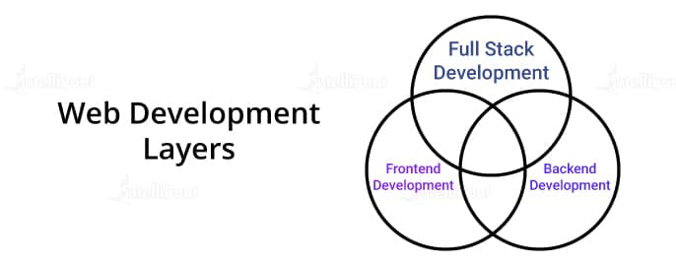
Frontend Web Development
This type of Web Development helps convert information and available data into a graphical user interface using CSS, HTML, and JavaScript such that users can easily interact with the provided interface. It deals with the part of the website that users can see and easily comprehend.
For instance, on your browser, you as a user see and interact with the website’s frontend. It consists of all the things that you can view and experience directly, including colors, text, images, buttons, etc.
Backend Web Development
The backend part of any web page is the portion that users don’t or can’t see. It is the backbone of the website. Users cannot see it, but it is the part responsible for the functioning of the website. It allows developers to store and organize data, as well as ensures the proper working and functioning of everything available on the frontend or the client-side.
The backend portion interacts with the frontend part of the web page by sending and receiving data that is shown live on the website. When users enter some data, fill out forms, or purchase something, the browser sends that request to the backend (the server-side) which, in turn, sends back the data as frontend code for the web page to comprehend, interpret, and make it visible for you.

Slide 12
Full Stack Web Development
Full Stack development is the combined development of the frontend and the backend of a web page. It includes the development of the graphics and design of the web page, along with managing the database for data organization and storage.
Future Scope of Web Development
With technologies like Machine Learning, Artificial Intelligence (AI), Data Science, and more rising day by day in terms of need and use, they can immensely help in the field of Web Development, thereby increasing the opportunities for Web Developers. No matter what requirements change the future holds, Web Developer Skills will always be in demand. Web Development offers some of the most secure and promising careers that you can opt for with numerous job opportunities available.

Slide 13
PROJECT WORKFLOW
BACKGROUND OF PROJECT:
Library Management System is an application which refers to library systems which are generally small or medium in size. It is used by librarian to manage the library using a computerized system where he/she can record various transactions like issue of books, return of books, addition of new books, addition of new students etc. Books and student maintenance modules are also included in this system which would keep track of the students using the library and also a detailed description about the books a library contains. With this computerized system there will be no loss of book record or member record which generally happens when a non computerized system is used.
In addition, report module is also included in Library Management System. If user’s position is admin, the user is able to generate different kinds of reports like lists of students registered, list of books, issue and return reports. All these modules are able to help librarian to manage the library with more convenience and in a more efficient way as compared to library systems which are not computerized.
SOFTWARE TOOLS USED
The whole Project is divided in two parts the front end and the back end.
Front end
The front end is designed using of HTML , PHP ,CSS, Java script
HTML-HTML or Hyper Text Markup Language is the main markup language for creating web pages and other information that can be displayed in a web browser. HTML is written in the form of HTML elements consisting of tags enclosed in angle brackets (like <html>), within the web page content. HTML tags most commonly come in pairs like <h1> and </h1>,although some tags represent empty elements
and so are unpaired, for example <img>. The first tag in a pair is the start tag, and the second tag is the end tag (they are also called opening tags and closing tags). In between these tags web designers can add text, further tags, comments and other types of text-based content. The purpose of a web browser is to read HTML documents and compose them into visible or audible web pages. The browser does not display the HTML tags, but uses the tags to interpret the content of the page.HTML elements form the building blocks of all websites.HTML allows images and objects to be embedded and can be used to create interactive forms. It provides a means to create structured documents by denoting structural semantics for text such as headings, paragraphs, lists, links, quotes and other items. It can embed scripts written in languages such as JavaScript which affect the behavior of HTML webpages.

Slide 14
CSS-Cascading Style Sheets(CSS) is a style sheet language used for describing the look and formatting of a document written in a markup language. While most often used to style web pages and interfaces written in HTML and XHTML, the language can be applied to any kind of XML document, including plain XML, SVG and XUL. CSS is a cornerstone specification of the web and almost all web pages use CSS style sheets to describe their presentation.CSS is designed primarily to enable the separation of document content from document presentation, including elements such as the layout, colors, and fonts. This separation can improve content accessibility, provide more flexibility and control in the specification of presentation characteristics, enable multiple pages to share formatting, and reduce complexity and repetition in the structural content (such as by allowing for table less web design). CSS can also allow the same markup page to be presented in different styles for different rendering methods, such as on-screen, in print, by voice (when read out by a speech-based browser or screen reader) and on Braille-based, tactile devices. It can also be used to allow the web page to display differently depending on the screen size or device on which it is being viewed. While the author of a document typically links that document to a CSS file, readers can use a different style sheet, perhaps one on their own computer, to override the one the author has specified. However if the author or the reader did not link the document to a specific style sheet the default style of the browser will be applied. CSS specifies a priority scheme to determine which style rules apply if more than one rule matches against a particular element. In this so-called cascade, priorities or weights are calculated and assigned to rules, so that the results are predictable.
JAVA SCRIPT-JavaScript(JS) is a dynamic computer programming language. It is most commonly used as part of web browsers, whose implementations allow client-side scripts to interact with the user, control the browser, communicate asynchronously, and alter the document content that is displayed. It is also being used in server-side programming, game development and the creation of desktop and mobile applications. JavaScript is a prototype-based scripting language with dynamic typing and has first-class functions. Its syntax was influenced by C. JavaScript copies many names and naming conventions from Java, but the two languages are otherwise unrelated and have very different semantics. The key design principles within JavaScript are taken from the Self and Scheme programming languages. It is a multi-paradigm language, supporting object-oriented, imperative, and functional programming styles. The application of JavaScript to use outside of web pages for example, in PDF documents, site-specific browsers, and desktop widgets is also significant. Newer and faster JavaScript VMs and platforms built upon them (notably Node.js) have also increased the popularity of JavaScript for server-side web applications. On the client side, JavaScript was traditionally implemented as an interpreted language but just-in-time compilation is now performed by recent (post-2012) browsers.

Slide 15
PHP-PHP is a server-side scripting language designed for web development but also used as a general-purpose programming language. PHP is now installed on more than 244 million websites and 2.1 million webservers. Originally created by Rasmus Lerdorf in 1995, the reference implementation of PHP is now produced by The PHP Group. While PHP originally stood for Personal Home Page, it now stands for PHP: Hypertext Preprocessor , a recursive backronym. PHP code is interpreted by a webserver with a PHP processor module, which generates the resulting webpage: PHP commands can be embedded directly into an HTML source document rather than calling an external file to process data. It has also evolved to include a command-line interface capability and can be used in standalone graphical applications.
PHP is free software released under the PHP License. PHP can be deployed on most web servers and also as a standalone shell on almost every operating system and platform, free of charge.
BACK END
The back end is designed using MySQL which is used to design the databases.
MYSQL-MySQL("My S-Q-L", officially, but also called "My Sequel") is (as of July 2013) the world's second most widely used open-source relational database management system (RDBMS). It is named after co-founder Michael Widenius daughter, My. The SQL phrase stands for Structured Query Language. The MySQL development project has made its source code available under the terms of the GNU General Public License, as well as under a variety of proprietary agreements. MySQL was owned and sponsored by a single for-profit firm, the Swedish company MySQL AB, now owned by Oracle Corporation. MySQL is a popular choice of database for use in web applications, and is a central component of the widely used LAMP open source web application software stack (and other 'AMP' stacks). LAMP is an acronym for "Linux, Apache, MySQL, Perl/PHP/Python." Free-software-open source projects that require afull-featured database management system often use MySQL. For commercial use, several paid editions are available, and offer additional functionality. Applications which use MySQL databases include: TYPO3, MODx, Joomla, WordPress, phpBB, MyBB, Drupal and other software. MySQL is also used in many high-profile, large-scale websites, including Wikipedia, Google (though not for searches), Facebook, Twitter, Flickr, and YouTube.
XAMP is used for localhost server and MYSQL for database.
Bootstrap framework for a user friendly website.

Slide 16
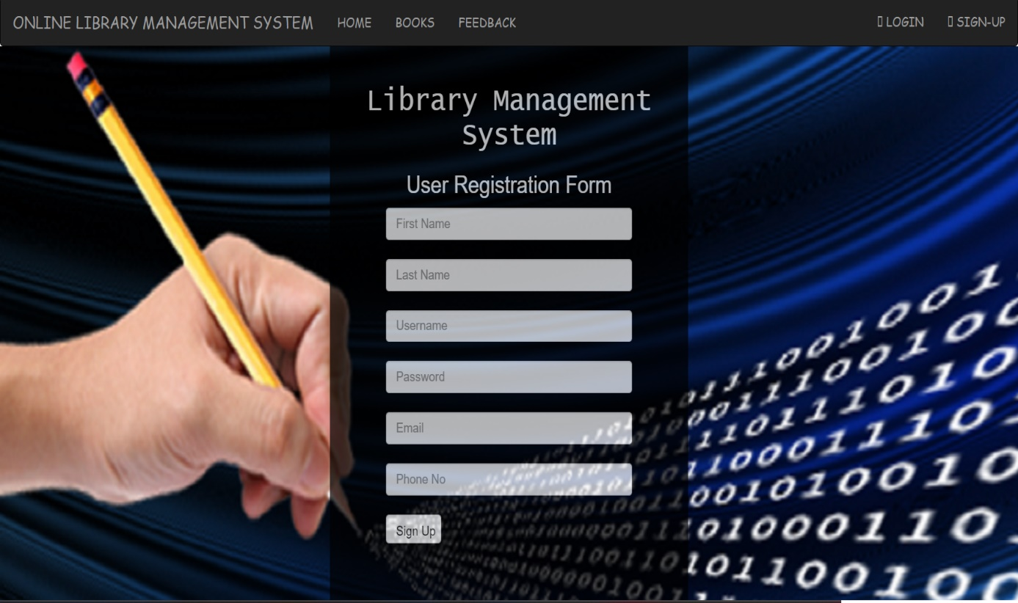
REGISTRATION PAGE:
This feature can be performed by all users to register new user to create account. Functional requirements:-
System must be able to verify information.
System must be able to delete information if information is wrong.
Attributes like First Name, Last Name, Username, Password, Email, Phone No are added and consists of a Sign Up Button.

Slide 17
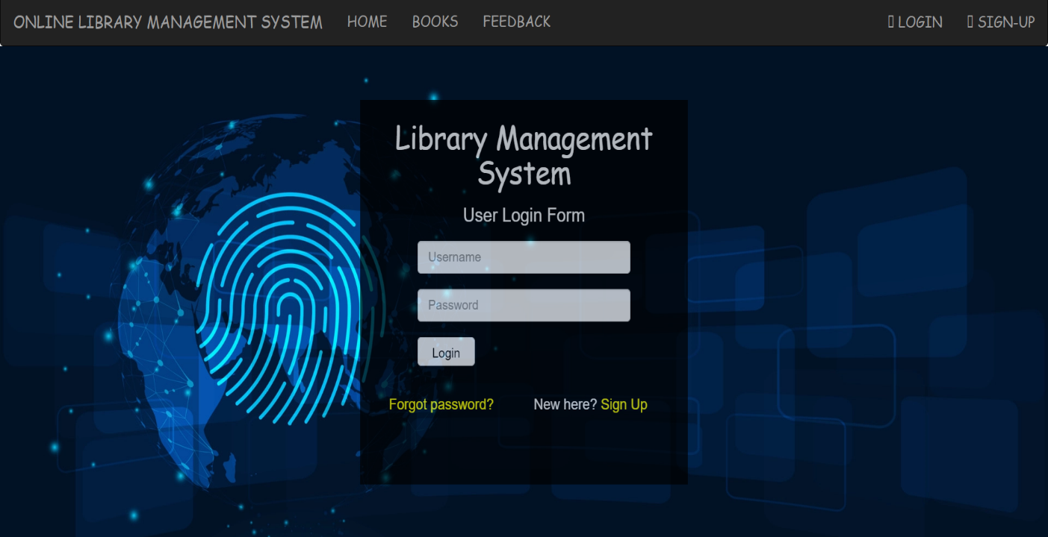
LOGIN PAGE:
This library management system must only allow a user with a valid id and password to become the beneficiary.
After this authorization takes place, to know all are the levels a particular user can access to.
Also, after finishing the work user must log out of the system to prevent the transaction from any intruder.
The attributes are Username, Password, and consists of a Login Button.

Slide 18
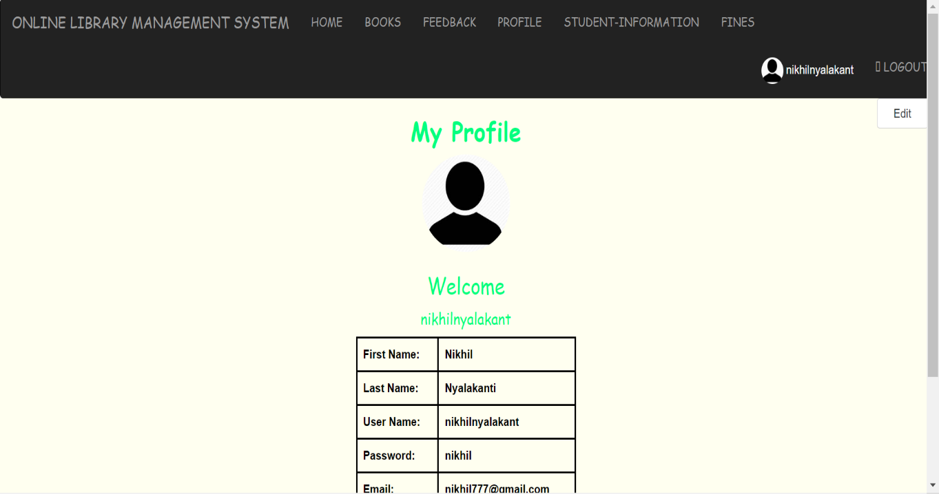
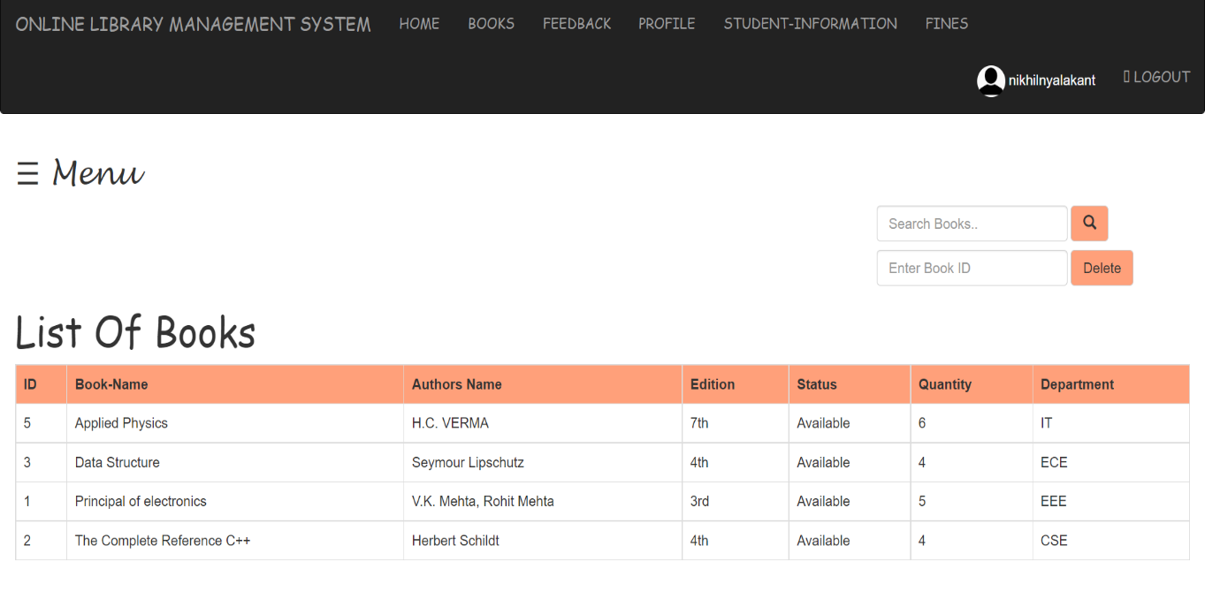
PROFILE PAGE:
The Profile Page consists of all the information related to the user.
MENU:

Slide 19
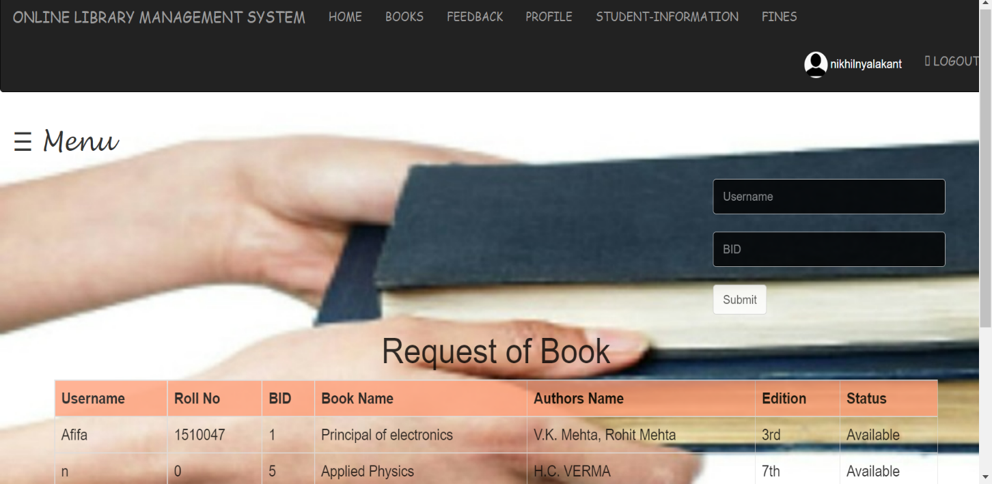

REQUEST OF BOOK:
LIST OF BOOKS:

Slide 20
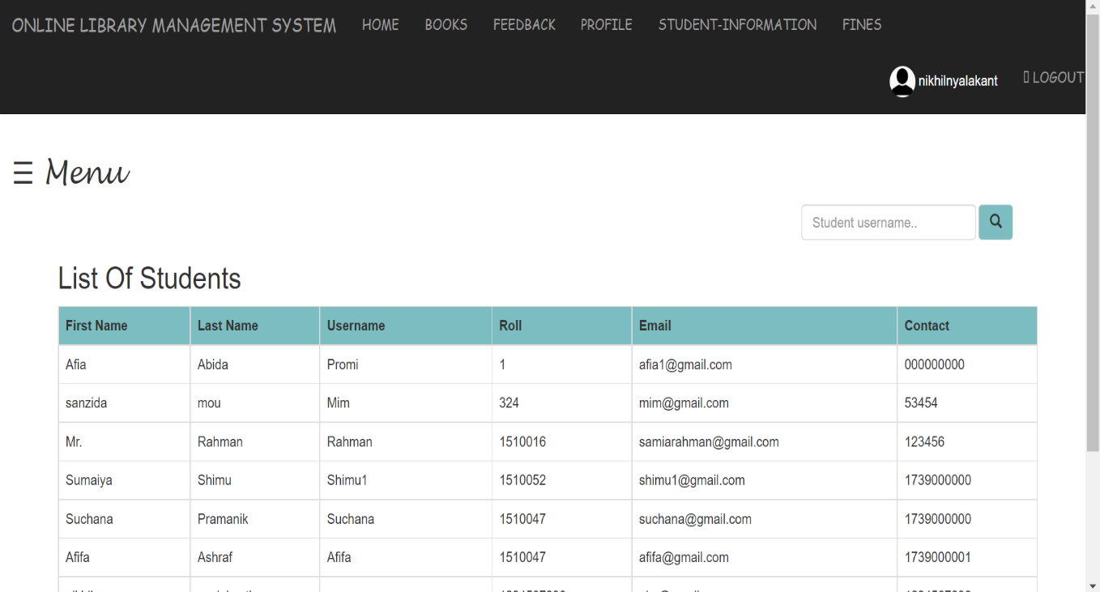
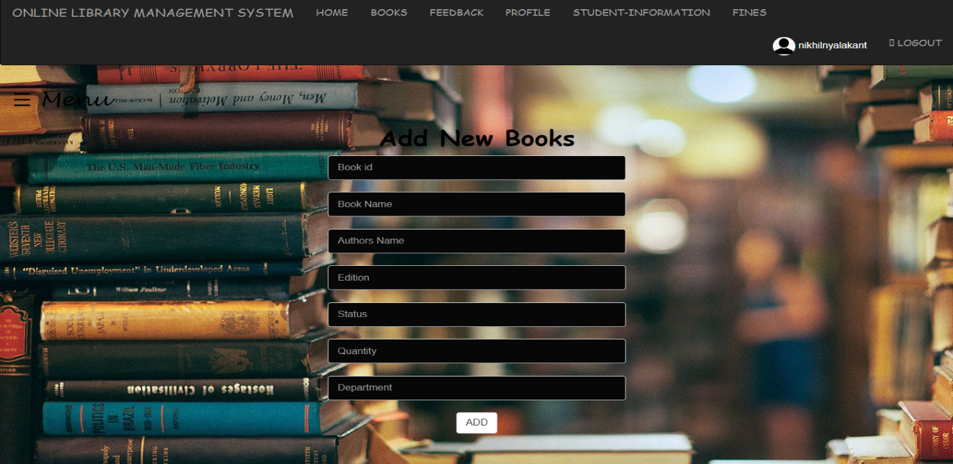
LIST OF STUDENTS:
ADD NEW BOOKS:

Slide 21
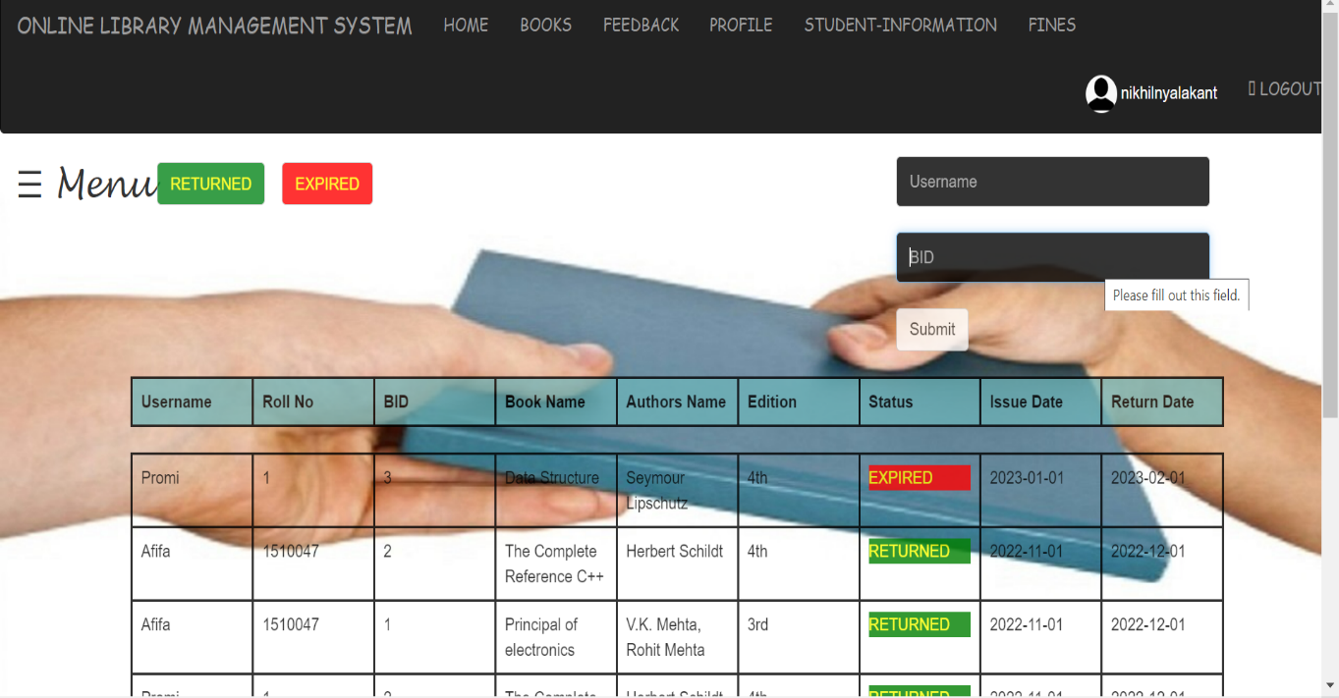
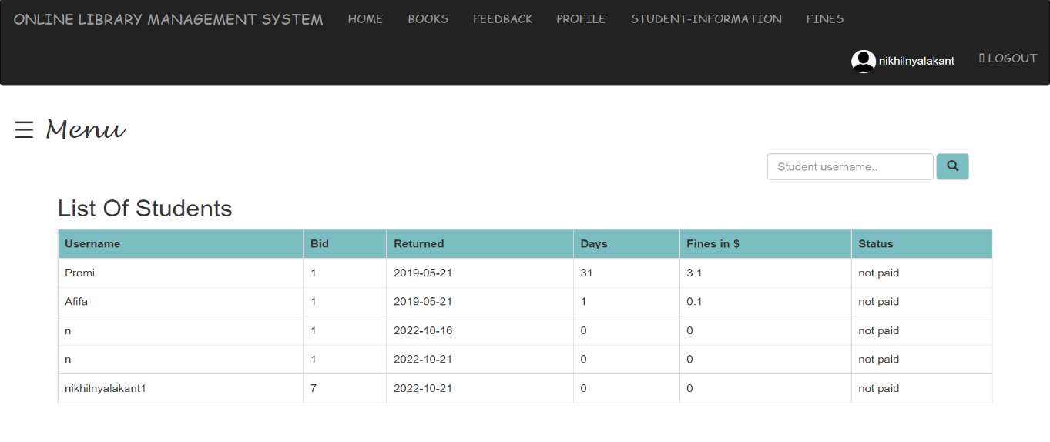
EXPIRED LIST:
FINES:

Slide 22
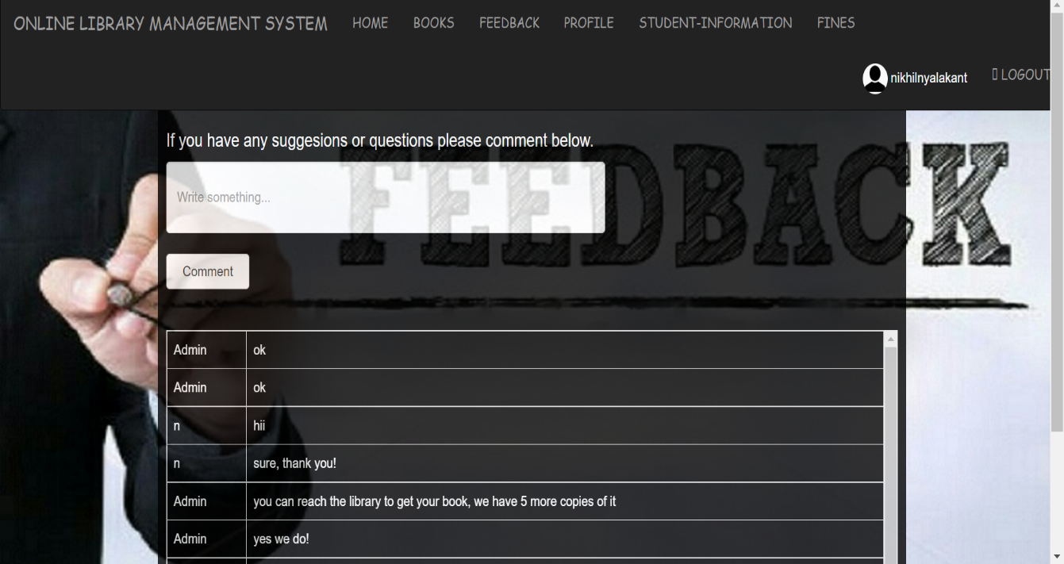
FEEDBACK:

Slide 23
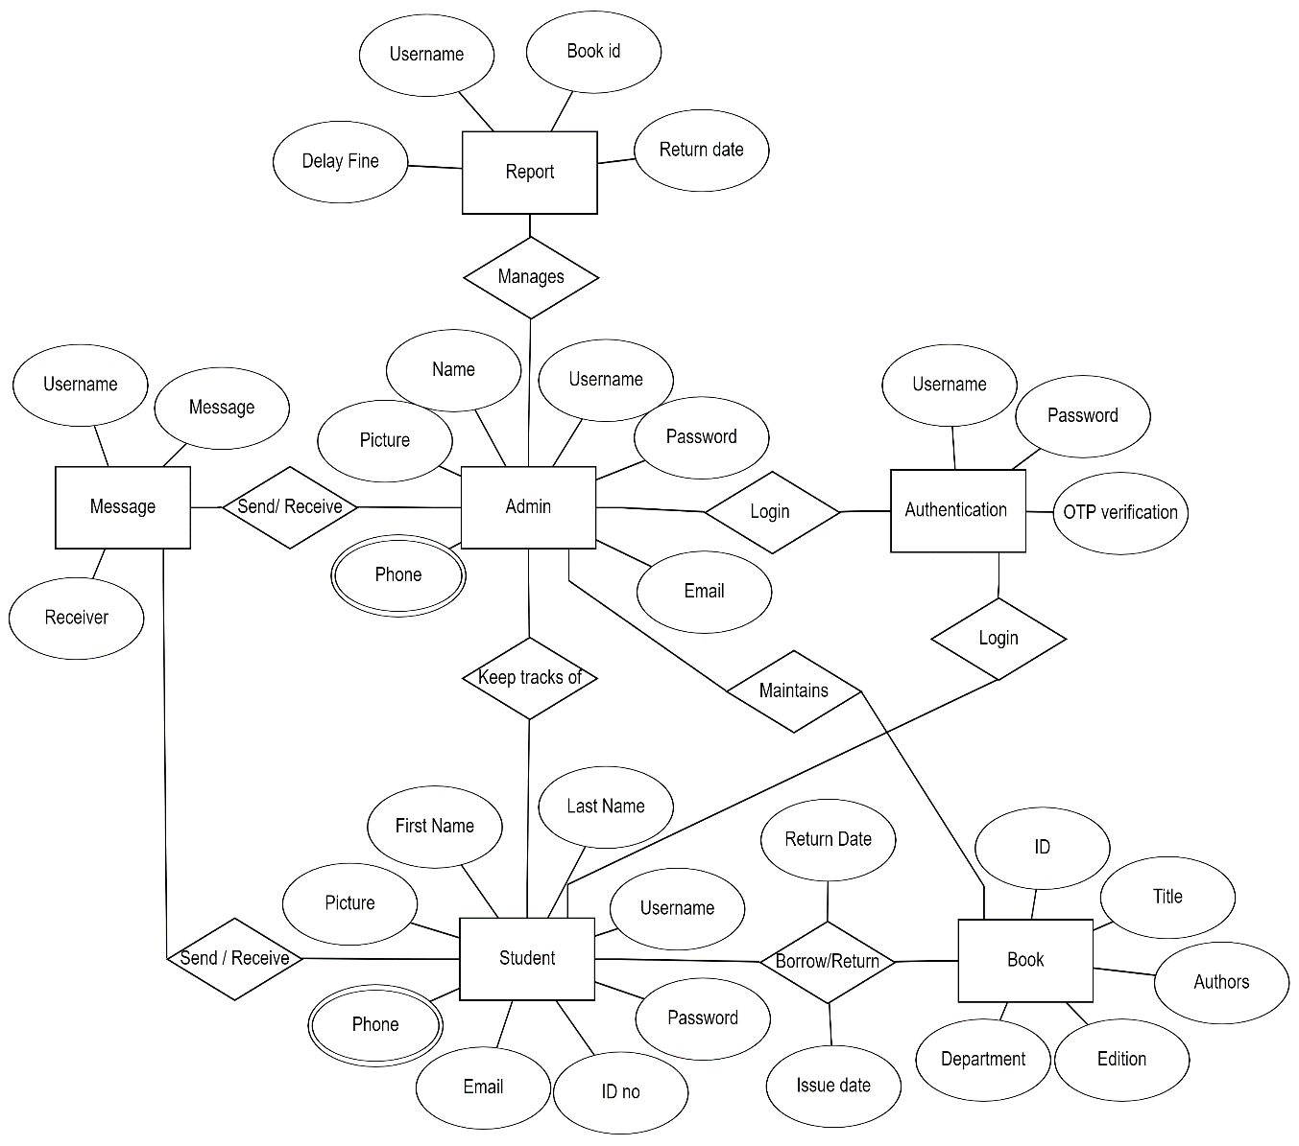
ER DIAGRAM

Slide 24
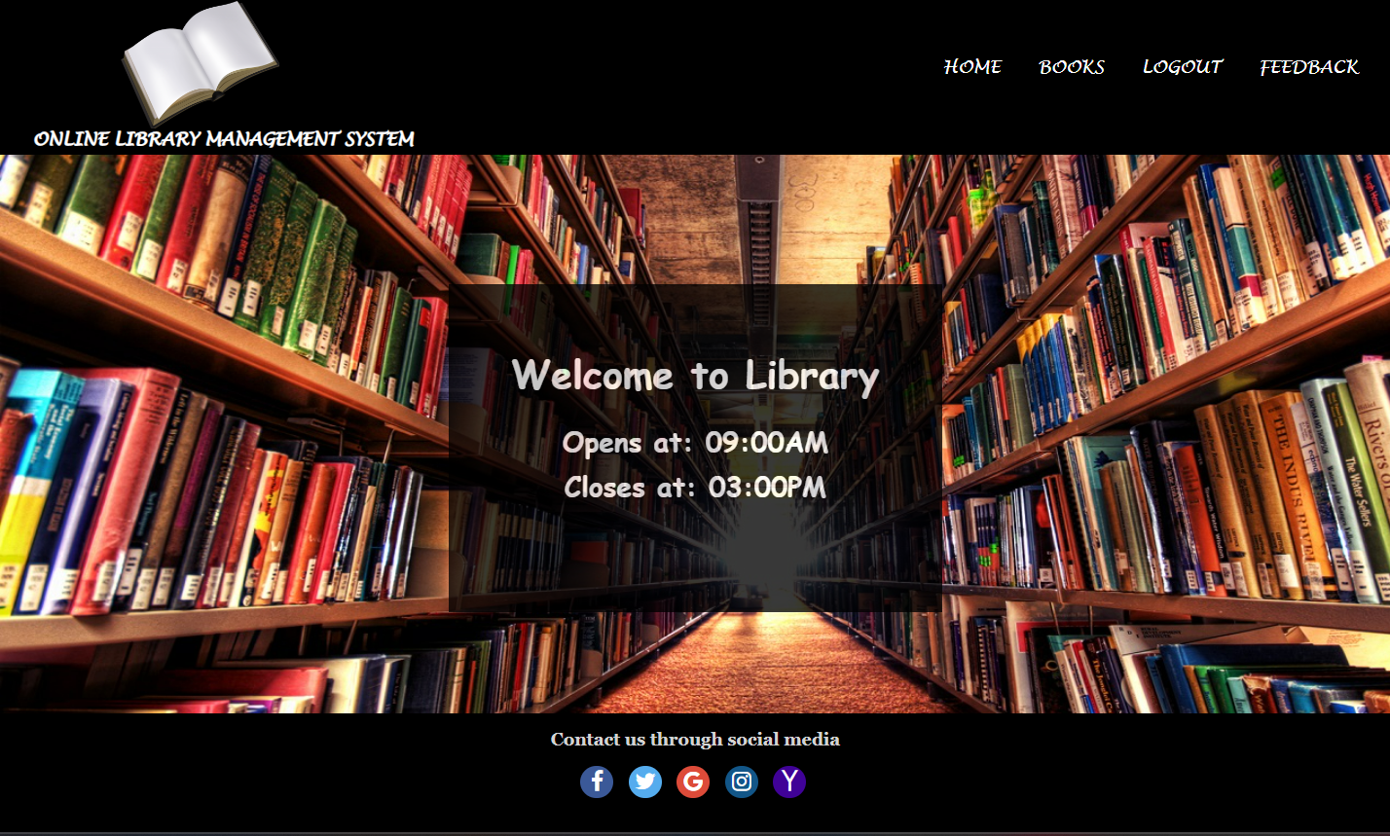
RESULTS
This website provides a computerized version of library management system which will benefit the students as well as the staff of the library.
It makes entire process online where student can search books, staff can generate reports and do book transactions.
It also has a facility for student login where student can login and can see status of books issued as well request for book or give some suggestions.
It has a facility of teacher’s login where teachers can add lectures notes and also give necessary suggestion to library and also add info about workshops or events happening in our college or nearby college in the online notice board.

Slide 25
FUTURE DEVELOPMENTS
There is a future scope of this facility that many more features such as online lectures video tutorials can be added by teachers as well as online assignments submission facility , a feature of group chat where students can discuss various issues of engineering can be added to this project thus making it more interactive more user friendly and project which fulfills each users need in the best way possible.
Barcoding enable users to find the book's exact location and number of books available in real-time, as well as print library cards.
Discard large collection of books with low circulation Automated library management system enable academic libraries to configure and customize rules for circulation.

Slide 26
REFERENCES
https://1000projects.org/library-management-system-database-project-using-php-mysql-ms-access.html
(PDF) Library Management System Mini Project Report On LIBRARY MANAGEMENT SYSTEM | Bibek Chaulagain and Bilal Awan - Academia.edu
Library Management System Project For Final Year (lovelycoding.org)
Library Management System - an overview | ScienceDirect Topics
Library Management System Project – ProjectsGeek
Library Management System website in PHP – YouTube
(PDF) Design of Library Management System (researchgate.net)
Design of Library Management System (scirp.org)

